Slide 1
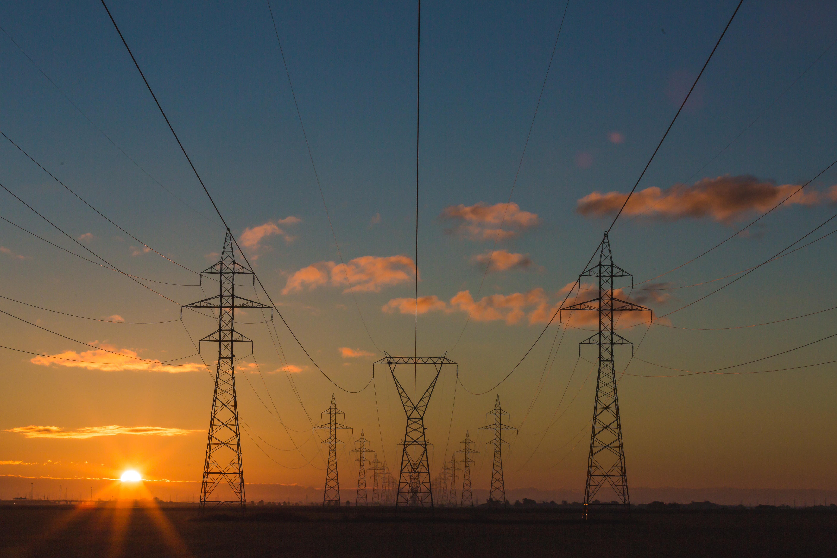
Predicting Energy Consumption for Power Systems Planning
John Muhs and Corbett Carrel
Introduction to Data Science
University of Utah
Photo by Matthew Henry on Unsplash

Slide 2
Before we begin…
Clone this Git Repository:
https://github.com/ronmexico7811/meetup-presentation-slcpy.git
Install Jupyter Notebooks through Anaconda
Install the following Python 3 Packages
pandas, numpy
matplotlib
scipy
Sklearn
Photo by Matthew Henry on Unsplash

Slide 3
Why Forecast Energy Consumption?
Long-Term (Annual Trends)
Transmission Planning
Generation Planning
Day-Ahead Forecasting
Dispatch Schedules
Ancillary Services

Slide 4
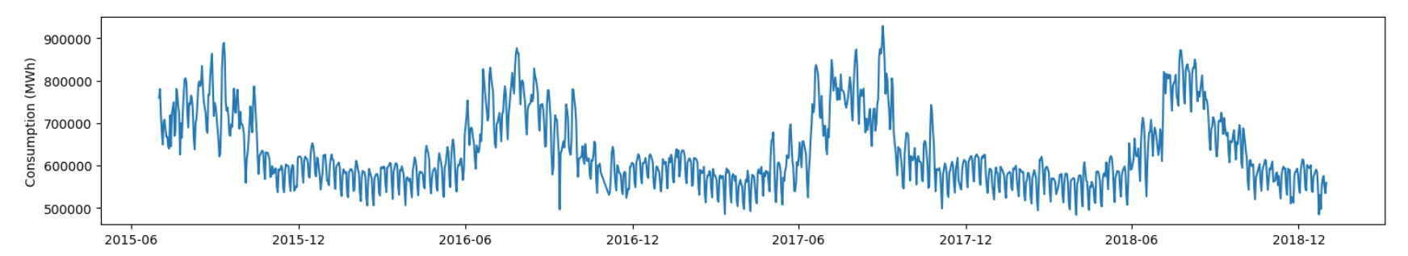
What Influences Energy Consumption?
Short-Term Trends
Day of the Week
Weekend vs. Weekday
Holidays
Seasonal Trends
Weather
Appliance Usage
Distributed Renewables
Long-Term Trends
Economic Factors
Population Growth
Renewable Integration

Slide 5
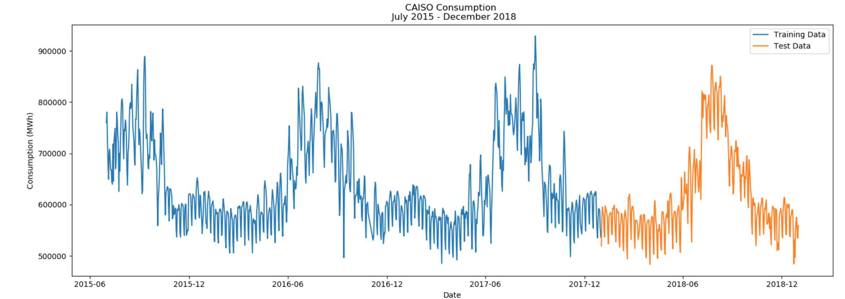
Machine Learning Approach
Objective: Use 2.5 years of historical weather, economic, and population data to predict energy consumption for the California ISO.
Linear Regression
Multi-Layer Perceptron (Neural Network) Regression

Slide 6
Data Import
Energy Information Agency API
CAISO Hourly Energy Consumption
California Region Energy Consumption
Number of CAISO Power Customers
Dark Sky API
Temperature
Dew Point
Pressure
Precipitation
Cloud Cover
Other Weather Parameters
Bureau of Economic Analysis
California Population
U.S. Gross Domestic Product
Pandas DataFrame
July 2015 – Dec 2018
Daily Time Resolution
30 Initial Variables

Slide 7
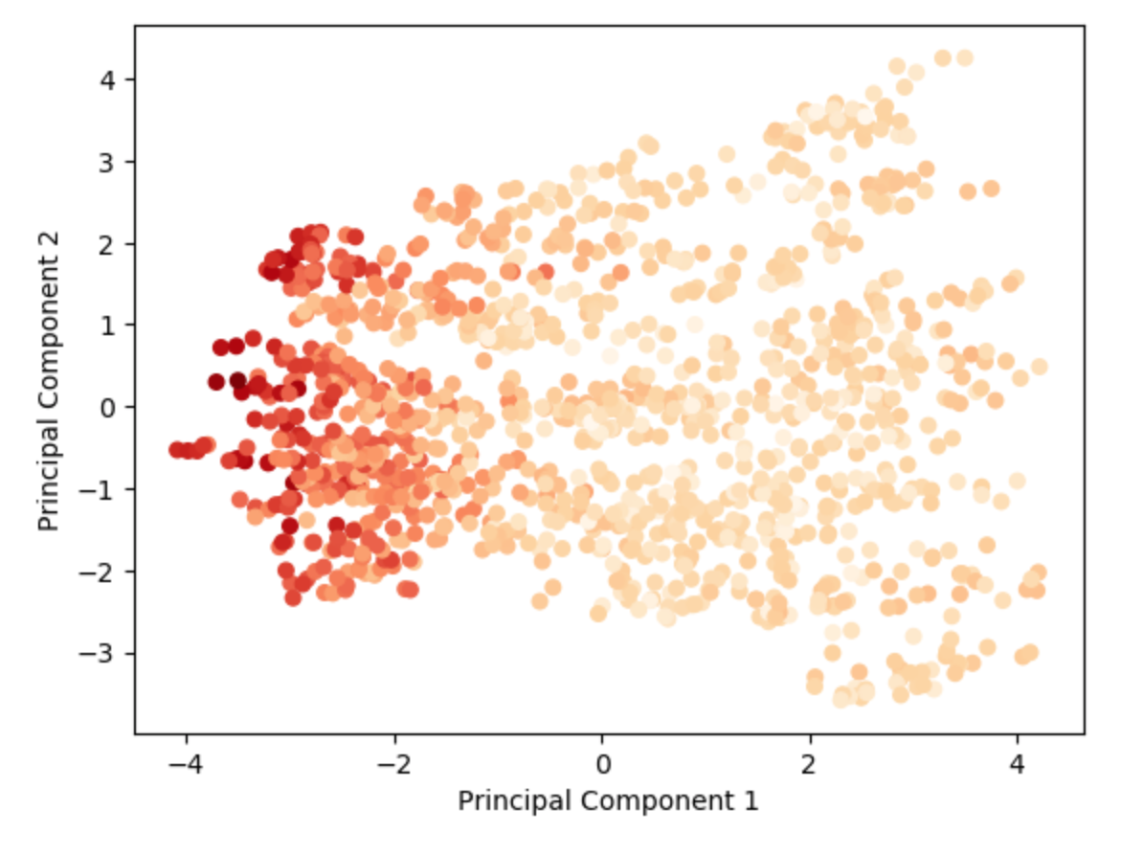
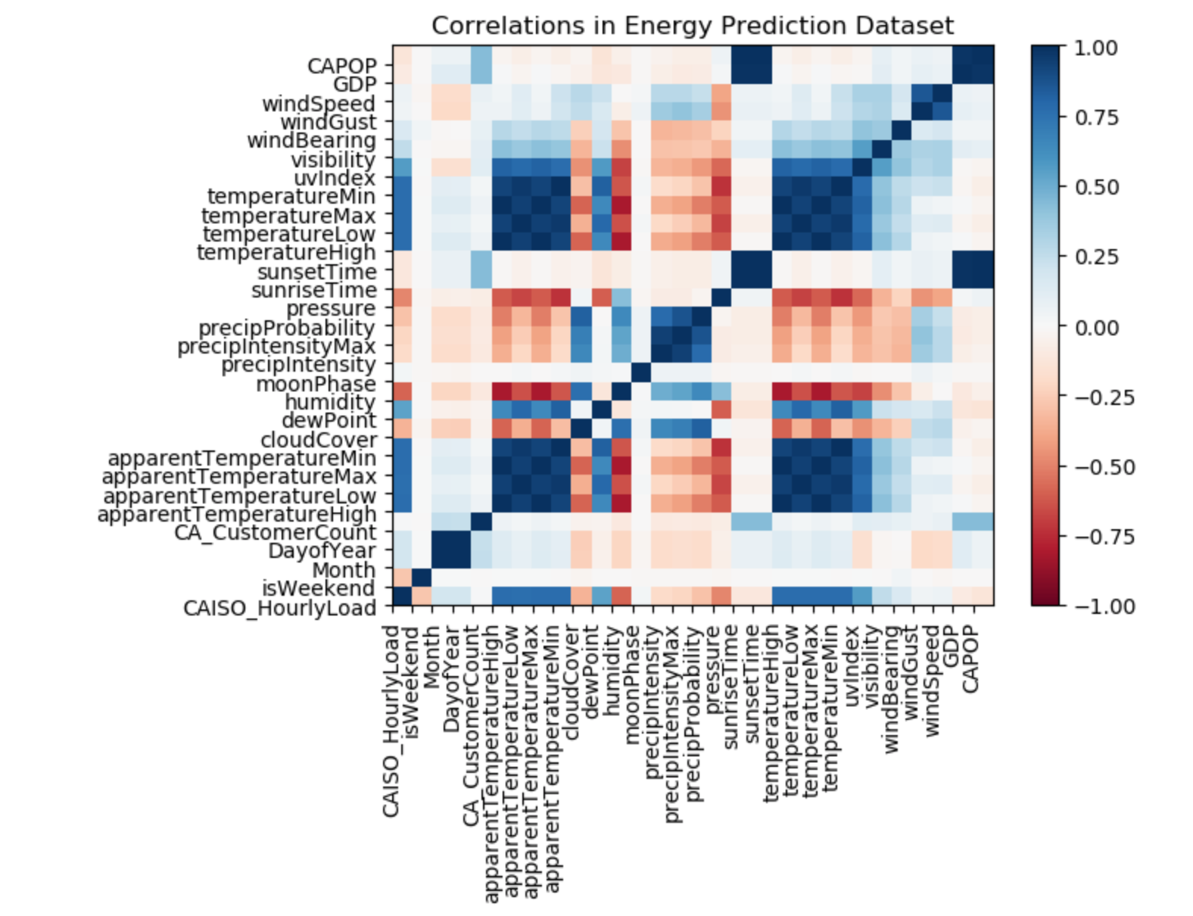
Dimension Reduction
Empirical Deduction
Principal Component Analysis

Slide 8
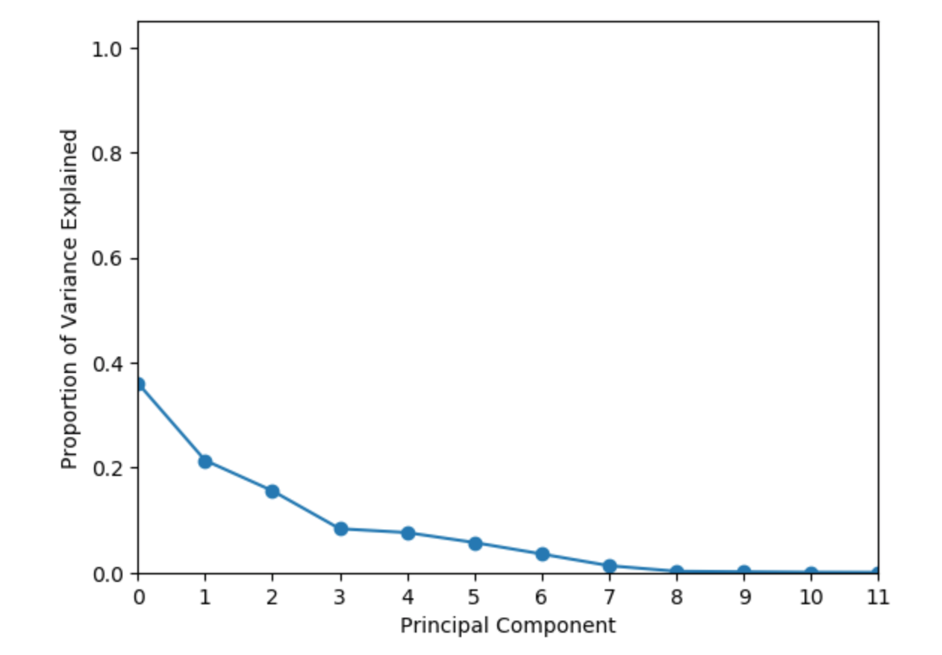
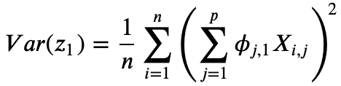
Principal Component Analysis
max

Slide 9
Energy Consumption Predictions

Slide 10
Model Comparison
Neural Network showed 6.36% reduction in RMS error
Linear regression much more straightforward to implement

Slide 11

Now onto the fun part…
Open a Jupyter Notebook in this Git Repository:
https://github.com/ronmexico7811/meetup-presentation-slcpy.git
Photo by Matthew Henry on Unsplash

